Slide 1
Microsoft Teams User Group Berlin
2. Dezember 2021

Slide 2
Danke!

Slide 3
Agenda
18:00 - 18:15 | Landing Zone
18:15 - 19:15 | Talk 1 – Content Migrationen nach Teams: The Good, The Bad and The Ugly Ragnar Heil (@ragnarh)
19:15 - 19:45 | Microsoft Teams Neuigkeiten Thomas Stensitzki (@stensitzki)
19:45 – 20:45 | Talk 2 – Microsoft Teams – Auto Attendant und Call Queue erklärt Thorsten Pickhan (@tpickhan)
20:45 - ? | Fragen und Antworten rund um Microsoft Teams Organisatorisches
Dieses Meeting wird aufgezeichnet und online bereitgestellt. This meeting will be recorded and made available online.

Slide 4
Content Migrationen nach Teams: The Good, The Bad and The Ugly
Ragnar Heil @ragnarh

Slide 5
Pause ☺
→ Um 19:30 Uhr geht es weiter

Slide 6
Neues in Microsoft Teams Ankündigungen & Rollouts
Updates
Meetup #16 Thomas Stensitzki

Slide 7
Neuigkeiten in Microsoft Teams
Improved Teams Guest User Usability
Switch between multiple video cameras in Microsoft Teams Rooms on Windows
Mirror my video
View Switcher - a new dedicated menu of view options in Teams Meetings
End-to-end encryption for Teams calling (→ Dezember)
Meeting Join Custom Branding
Transcription in 1:1 VOIP Calls

Slide 8
Improved Teams Guest User Usability
A guest user can now decline a pending guest invitation within Teams app
When the guest user clicks Decline, Teams Tenant List will not show the tenant with the pending invitation and in the Account Management tab
A guest user can now initiate leaving an org
Taking the user to the portal where the user can leave a guest tenant
When the guest user clicks Leave Org, user will be guided on how to leave a tenant from Teams and Azure Portal
A guest user can now manage guest tenant list by choosing to hide/show guest tenants
When the guest user clicks Hide/Show, the tenant will be shown (or hidden) in the Menu under the tenant list.

Slide 9
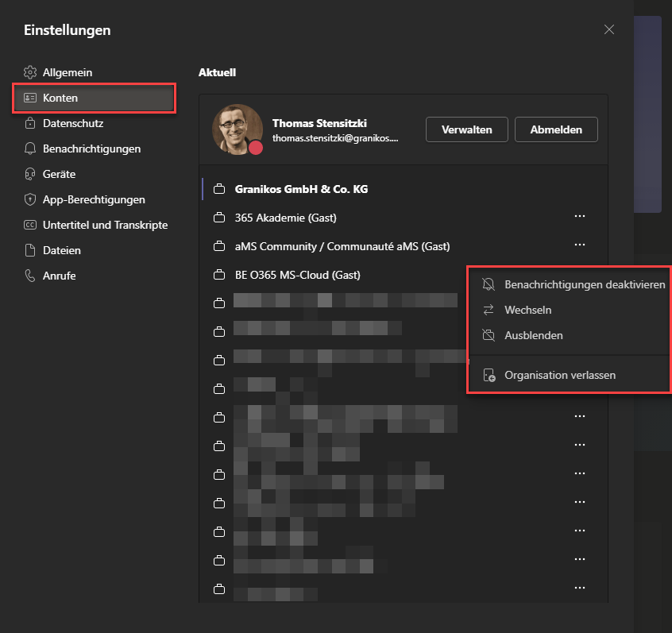
Improved Teams Guest User Usability

Slide 10
Neuigkeiten in Microsoft Teams
Improved Teams Guest User Usability
Switch between multiple video cameras in Microsoft Teams Rooms on Windows
Mirror my video
View Switcher - a new dedicated menu of view options in Teams Meetings
End-to-end encryption for Teams calling (→ Dezember)
Meeting Join Custom Branding
Transcription in 1:1 VOIP Calls

Slide 11
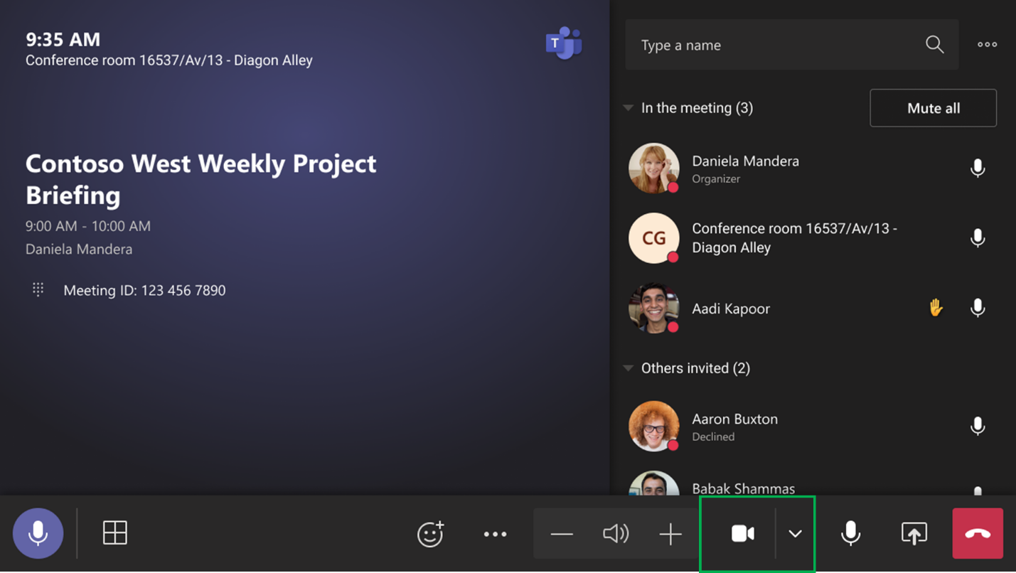
Switch between multiple video cameras in Microsoft Teams Rooms on Windows

Slide 12
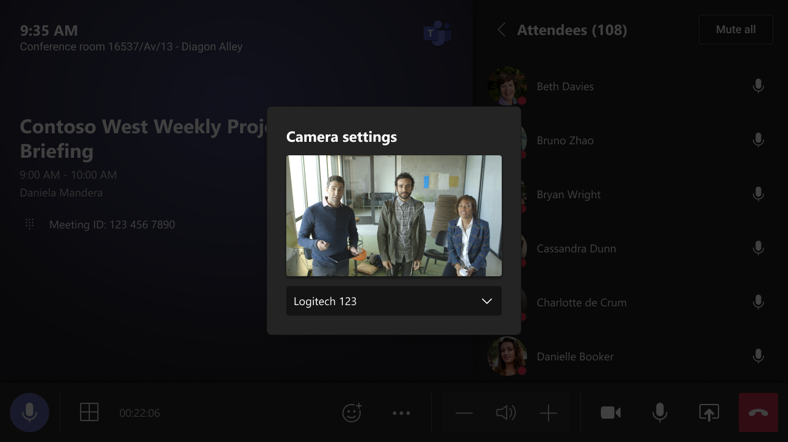
Switch between multiple video cameras in Microsoft Teams Rooms on Windows

Slide 13
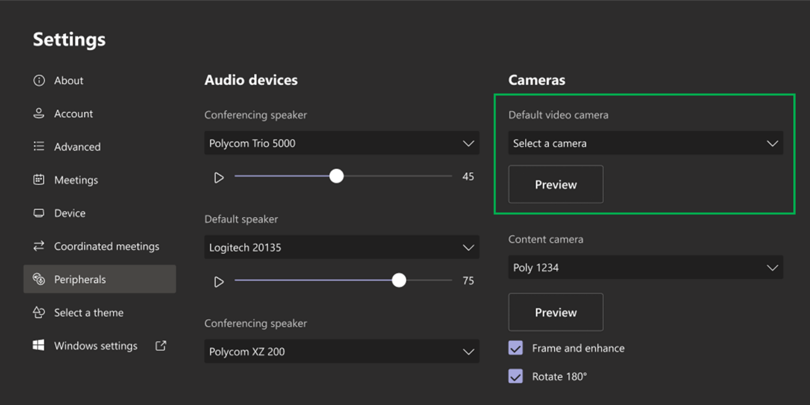
Switch between multiple video cameras in Microsoft Teams Rooms on Windows
Microsoft Teams Rooms for Windows only

Slide 14
Neuigkeiten in Microsoft Teams
Improved Teams Guest User Usability
Switch between multiple video cameras in Microsoft Teams Rooms on Windows
Mirror my video
View Switcher - a new dedicated menu of view options in Teams Meetings
End-to-end encryption for Teams calling (→ Dezember)
Meeting Join Custom Branding
Transcription in 1:1 VOIP Calls

Slide 15
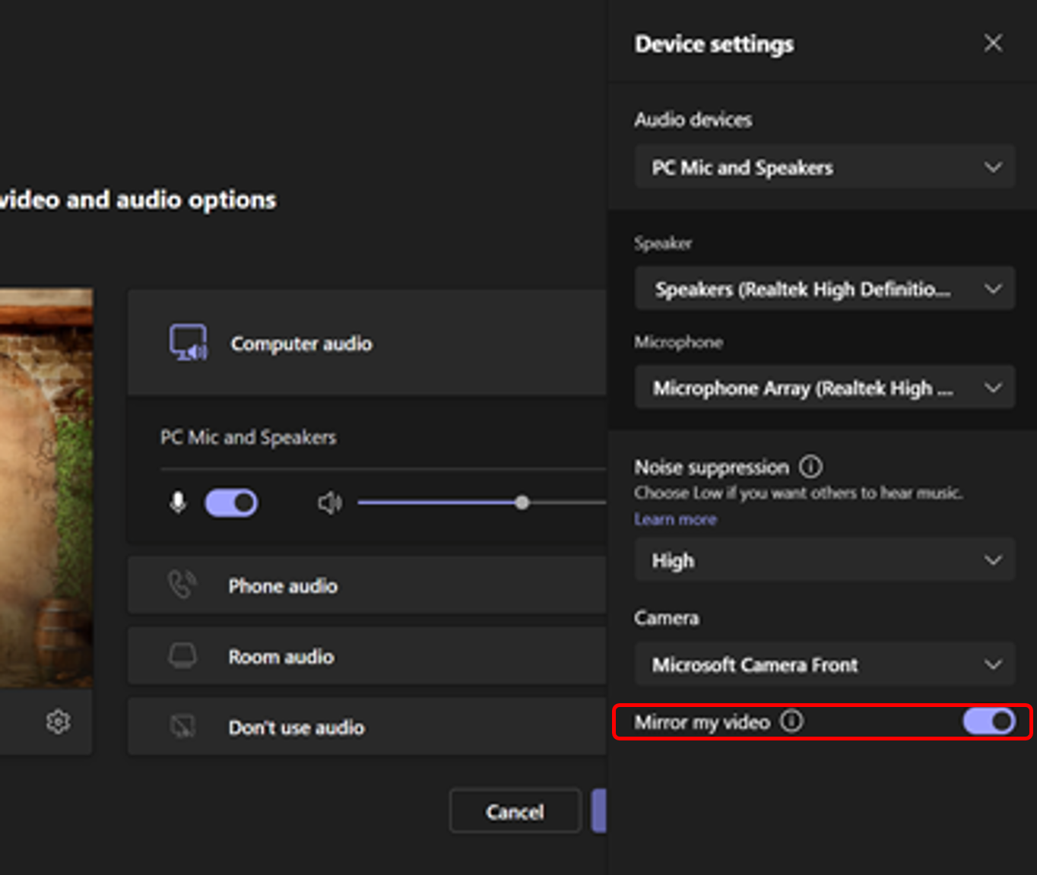
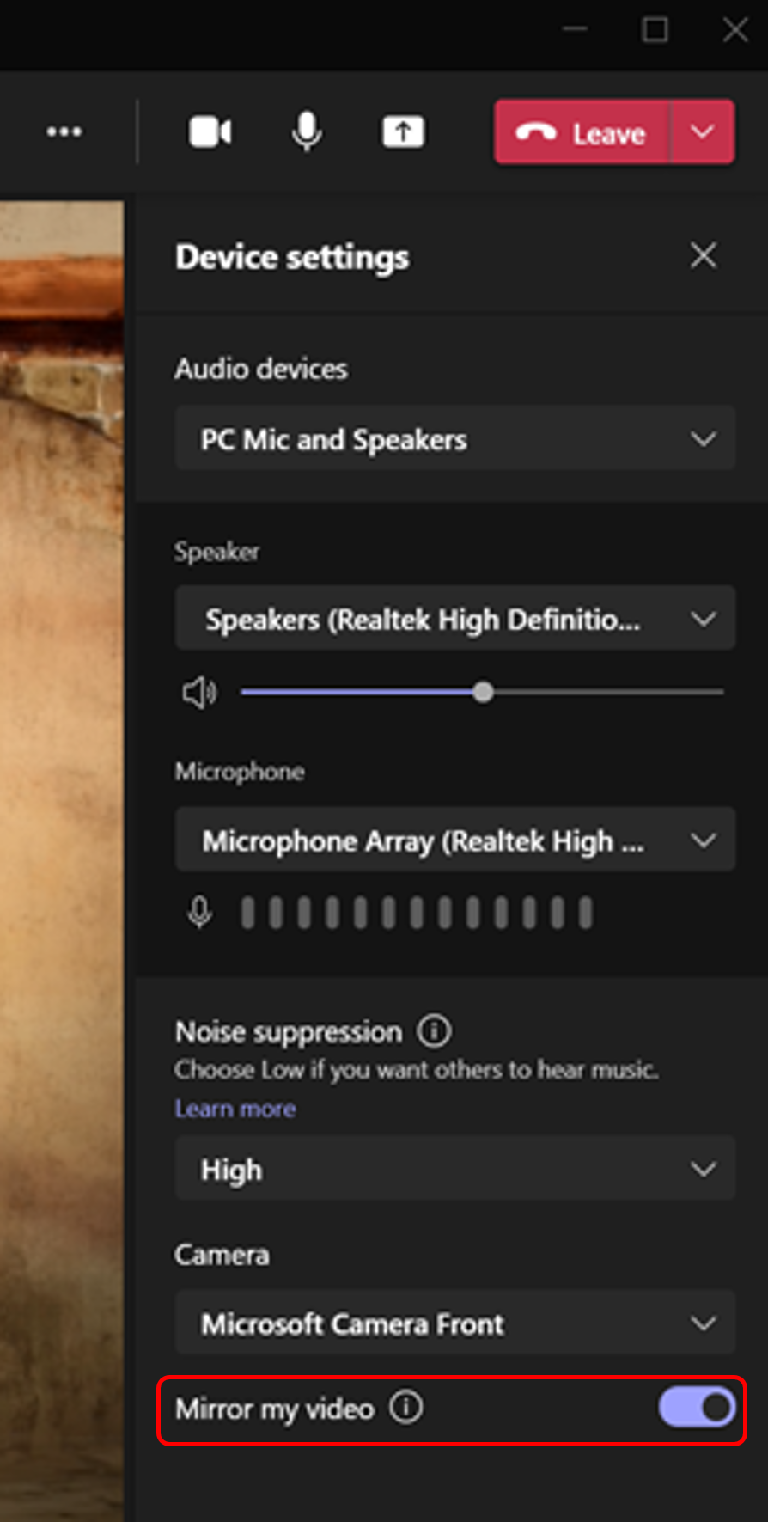
Mirror my video
Gallery
Large gallery
Preview videos
PowerPoint sharing – content only
PowerPoint live

Slide 16
Neuigkeiten in Microsoft Teams
Improved Teams Guest User Usability
Switch between multiple video cameras in Microsoft Teams Rooms on Windows
Mirror my video
View Switcher - a new dedicated menu of view options in Teams Meetings
End-to-end encryption for Teams calling (→ Dezember)
Meeting Join Custom Branding
Transcription in 1:1 VOIP Calls

Slide 17
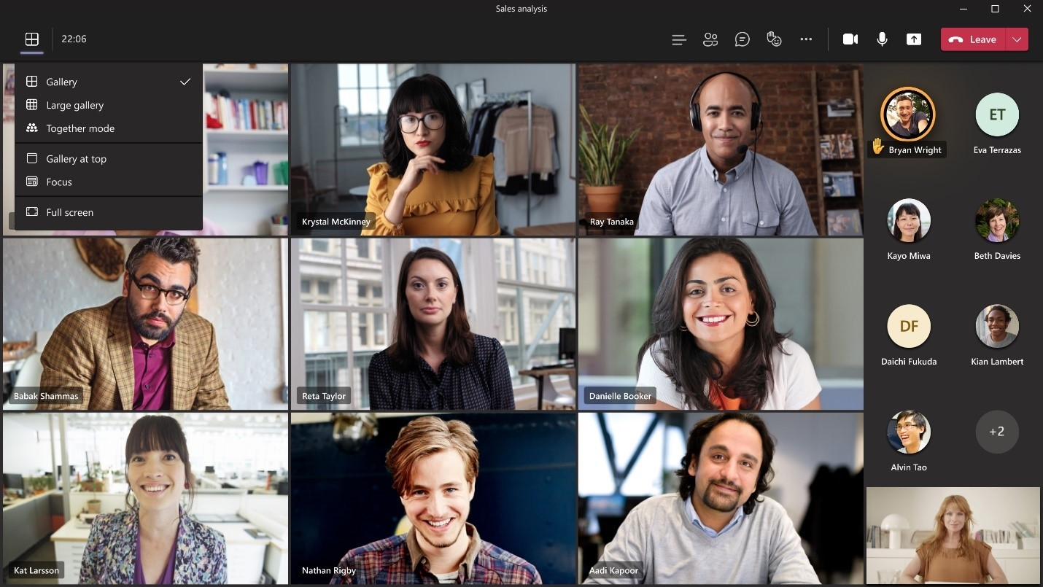
View Switcher - a new dedicated menu of view options in Teams Meetings
On-Hold kein weiterer Roll-Out

Slide 18
Neuigkeiten in Microsoft Teams
Improved Teams Guest User Usability
Switch between multiple video cameras in Microsoft Teams Rooms on Windows
Mirror my video
View Switcher - a new dedicated menu of view options in Teams Meetings
End-to-end encryption for Teams calling (→ Dezember)
Meeting Join Custom Branding
Transcription in 1:1 VOIP Calls

Slide 19
Neuigkeiten in Microsoft Teams
Improved Teams Guest User Usability
Switch between multiple video cameras in Microsoft Teams Rooms on Windows
Mirror my video
View Switcher - a new dedicated menu of view options in Teams Meetings
End-to-end encryption for Teams calling (→ Dezember)
Meeting Join Custom Branding
Transcription in 1:1 VOIP Calls

Slide 20
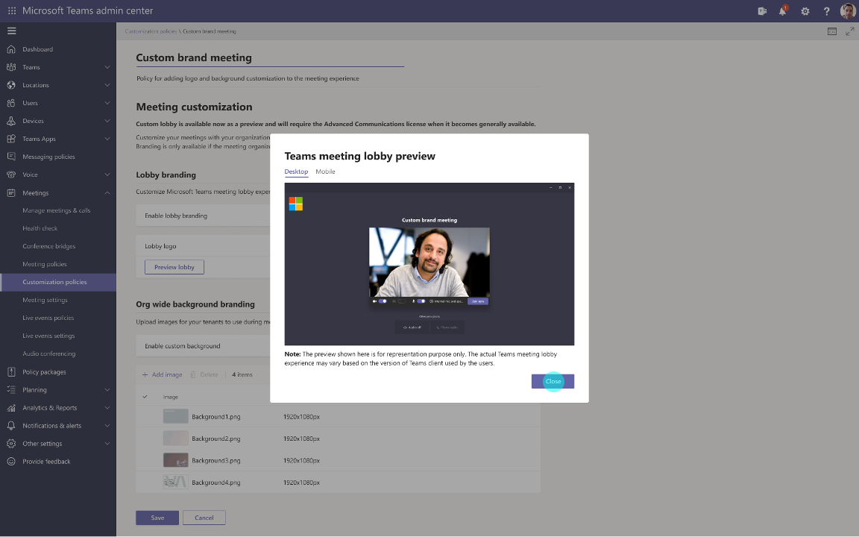
Meeting Join Custom Branding
On-Hold kein weiterer Roll-Out

Slide 21
Neuigkeiten in Microsoft Teams
Improved Teams Guest User Usability
Switch between multiple video cameras in Microsoft Teams Rooms on Windows
Mirror my video
View Switcher - a new dedicated menu of view options in Teams Meetings
End-to-end encryption for Teams calling (→ Dezember)
Meeting Join Custom Branding
Transcription in 1:1 VOIP Calls

Slide 22
Neuigkeiten in Microsoft Teams
Custom Backgrounds are now on Android Mobile Weitere Informationen
Co-Organizer Meeting Role
Introducing background effects on web (→ Dezember)
Microsoft Viva: Praise History in Microsoft Viva Insights (→ Dezember) Weitere Informationen
Expanded reactions in Microsoft Teams (→ Januar)
Q&A in Teams, Public Preview Weitere Informationen Weitere Informationen

Slide 23
Neuigkeiten in Microsoft Teams
Custom Backgrounds are now on Android Mobile Weitere Informationen
Co-Organizer Meeting Role
Introducing background effects on web (→ Dezember)
Microsoft Viva: Praise History in Microsoft Viva Insights (→ Dezember) Weitere Informationen
Expanded reactions in Microsoft Teams (→ Januar)
Q&A in Teams, Public Preview Weitere Informationen Weitere Informationen

Slide 24
Co-Organizer Meeting Role
Co-organizers can
Access and change meeting options
Bypass the lobby
Admit people from the lobby during a meeting
Lock the meeting
Present content
Change another participant’s meeting role
End the meeting for all
Co-organizers cannot
Create & manage breakout rooms
View & download attendance reports
Manage the meeting recording
Edit the meeting invitation
Remove or change the Organizer role
Notes:
Organizers will soon be able to assign the co-organizer meeting role to up to 10 specific people they invite to their meeting. Co-organizers will be displayed as additional organizers on the meeting roster.

Slide 25
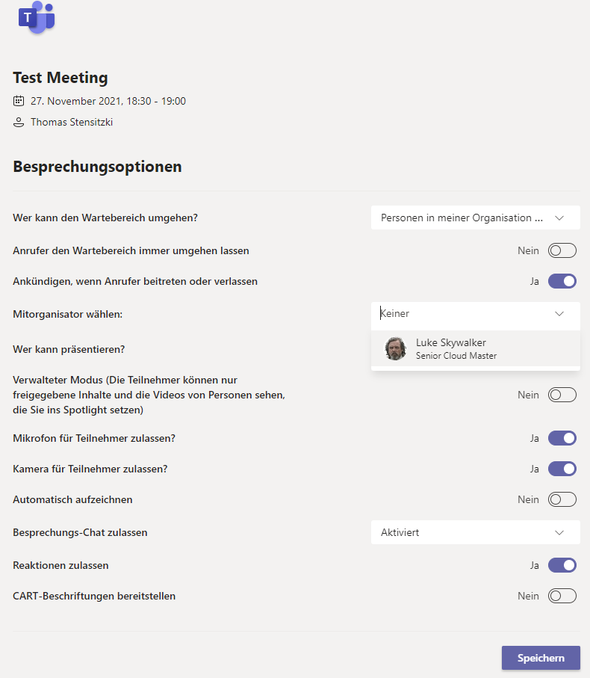
Co-Organizer Meeting Role

Slide 26
Neuigkeiten in Microsoft Teams
Custom Backgrounds are now on Android Mobile Weitere Informationen
Co-Organizer Meeting Role
Introducing background effects on web (→ Dezember)
Microsoft Viva: Praise History in Microsoft Viva Insights (→ Dezember) Weitere Informationen
Expanded reactions in Microsoft Teams (→ Januar)
Q&A in Teams, Public Preview Weitere Informationen Weitere Informationen

Slide 27
Neuigkeiten in Microsoft Teams
Custom Backgrounds are now on Android Mobile Weitere Informationen
Co-Organizer Meeting Role
Introducing background effects on web (→ Dezember)
Microsoft Viva: Praise History in Microsoft Viva Insights (→ Dezember) Weitere Informationen
Expanded reactions in Microsoft Teams (→ Januar)
Q&A in Teams, Public Preview Weitere Informationen Weitere Informationen

Slide 28
Neuigkeiten in Microsoft Teams
Custom Backgrounds are now on Android Mobile Weitere Informationen
Co-Organizer Meeting Role
Introducing background effects on web (→ Dezember)
Microsoft Viva: Praise History in Microsoft Viva Insights (→ Dezember) Weitere Informationen
Expanded reactions in Microsoft Teams (→ Januar)
Q&A in Teams, Public Preview Weitere Informationen Weitere Informationen

Slide 29
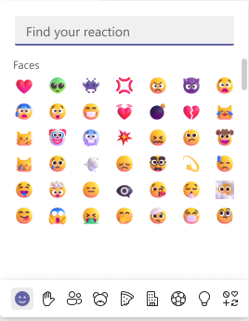
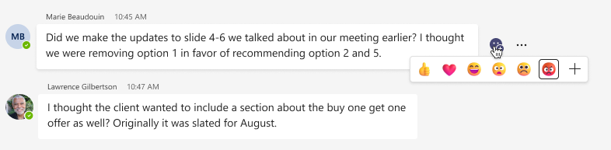
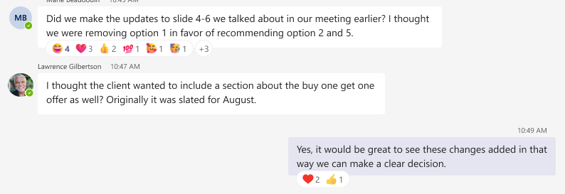
Expanded reactions in Microsoft Teams

Slide 30
Neuigkeiten in Microsoft Teams
Microsoft Teams tab actions are moving
Releasing Fluid live components in Teams chat (→ November) Weitere Informationen

Slide 31
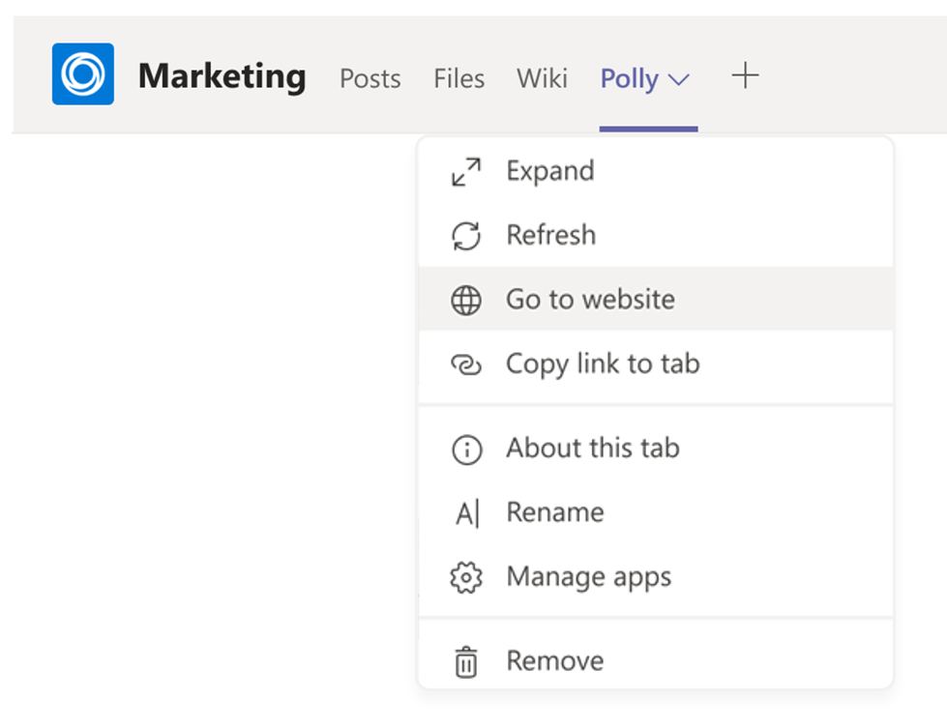
Microsoft Teams tab actions are moving
Microsoft & 3rd Party Apps
Affected Actions
Reload tab
Go to website
Copy link to tab
Pop-out tab
About this tab

Slide 32
Neuigkeiten in Microsoft Teams
Microsoft Teams tab actions are moving
Releasing Fluid live components in Teams chat (→ November) Weitere Informationen

Slide 33
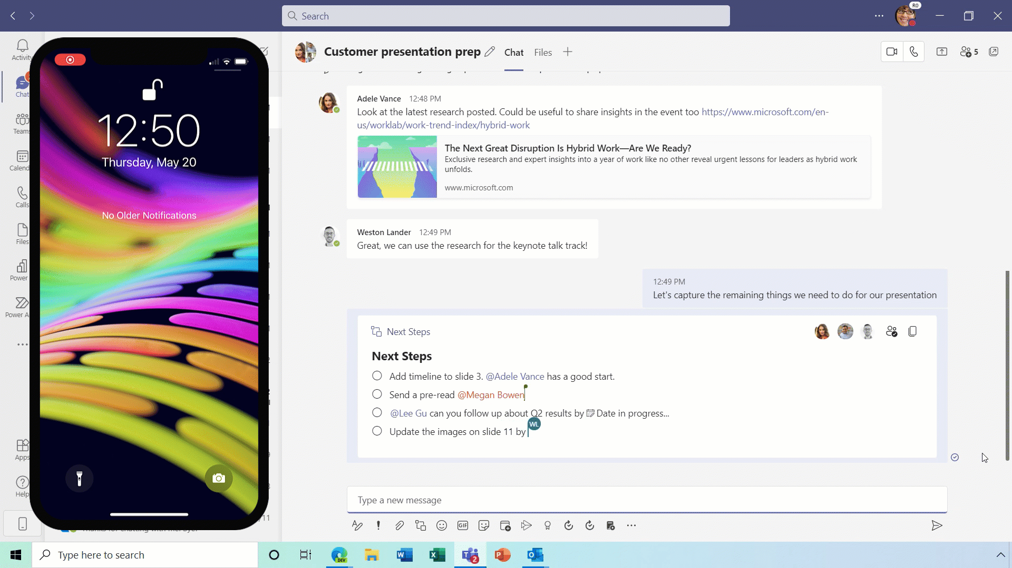
Releasing Fluid live components in Teams chat

Slide 34
Neuigkeiten in Microsoft Teams für Admins
Real time data for Teams Meetings in Teams Admin Center (Preview)
Anonymous join policy Weitere Informationen
Teams application update for Teams phones
Redesigned Microsoft Teams Store Experience
Meeting Activities in Teams Audit Log Weitere Informationen
TLS1.2 enforcement for Direct Routing SIP interface Weitere Informationen
Teams Meeting Recordings Auto-Expiration in OneDrive and SharePoint Weitere Informationen

Slide 35
Real time data for Teams Meetings in Teams Admin Center (Preview)
Updated Advanced Communications add-on license documentation
There are two ways to access this feature to monitor the user's telemetry
Search for the person's name in the recent meeting category and click on the Meeting ID of the 'in-progress' meeting
Click on the meeting's participants list, select the participant's name
Updated every 30 seconds
Notes:
This feature will provide the following options for Teams Admins to examine audio/video/content-sharing and network related issues in real-time. The real-time metrics are updated every 30 seconds. This feature can be accessed when a meeting is in progress via the Teams Admin Console.

Slide 36
Neuigkeiten in Microsoft Teams für Admins
Real time data for Teams Meetings in Teams Admin Center (Preview)
Anonymous join policy Weitere Informationen
Teams application update for Teams phones
Redesigned Microsoft Teams Store Experience
Meeting Activities in Teams Audit Log Weitere Informationen
TLS1.2 enforcement for Direct Routing SIP interface Weitere Informationen
Teams Meeting Recordings Auto-Expiration in OneDrive and SharePoint Weitere Informationen

Slide 37
Anonymous join policy
Per-Organizer Policy
Set-CsTeamsMeetingPolicy
AllowAnonymousUsersToJoinMeeting Parameter
Requires Teams PowerShell 2.6.0+
Phase 1
New policy roll-out
Tenant-wide setting will still exist
Phase 2
The Tenant-wide setting will be retired
The new per-organizer policy will fully control anonymous join

Slide 38
Neuigkeiten in Microsoft Teams für Admins
Real time data for Teams Meetings in Teams Admin Center (Preview)
Anonymous join policy Weitere Informationen
Teams application update for Teams phones
Redesigned Microsoft Teams Store Experience
Meeting Activities in Teams Audit Log Weitere Informationen
TLS1.2 enforcement for Direct Routing SIP interface Weitere Informationen
Teams Meeting Recordings Auto-Expiration in OneDrive and SharePoint Weitere Informationen

Slide 39
Teams application update for Teams phones
Starting November 19, 2021 Updates via Teams Admin Center for
Audiocodes
Crestron
Yealink

Slide 40
Neuigkeiten in Microsoft Teams für Admins
Real time data for Teams Meetings in Teams Admin Center (Preview)
Anonymous join policy Weitere Informationen
Teams application update for Teams phones
Redesigned Microsoft Teams Store Experience
Meeting Activities in Teams Audit Log Weitere Informationen
TLS1.2 enforcement for Direct Routing SIP interface Weitere Informationen
Teams Meeting Recordings Auto-Expiration in OneDrive and SharePoint Weitere Informationen

Slide 41
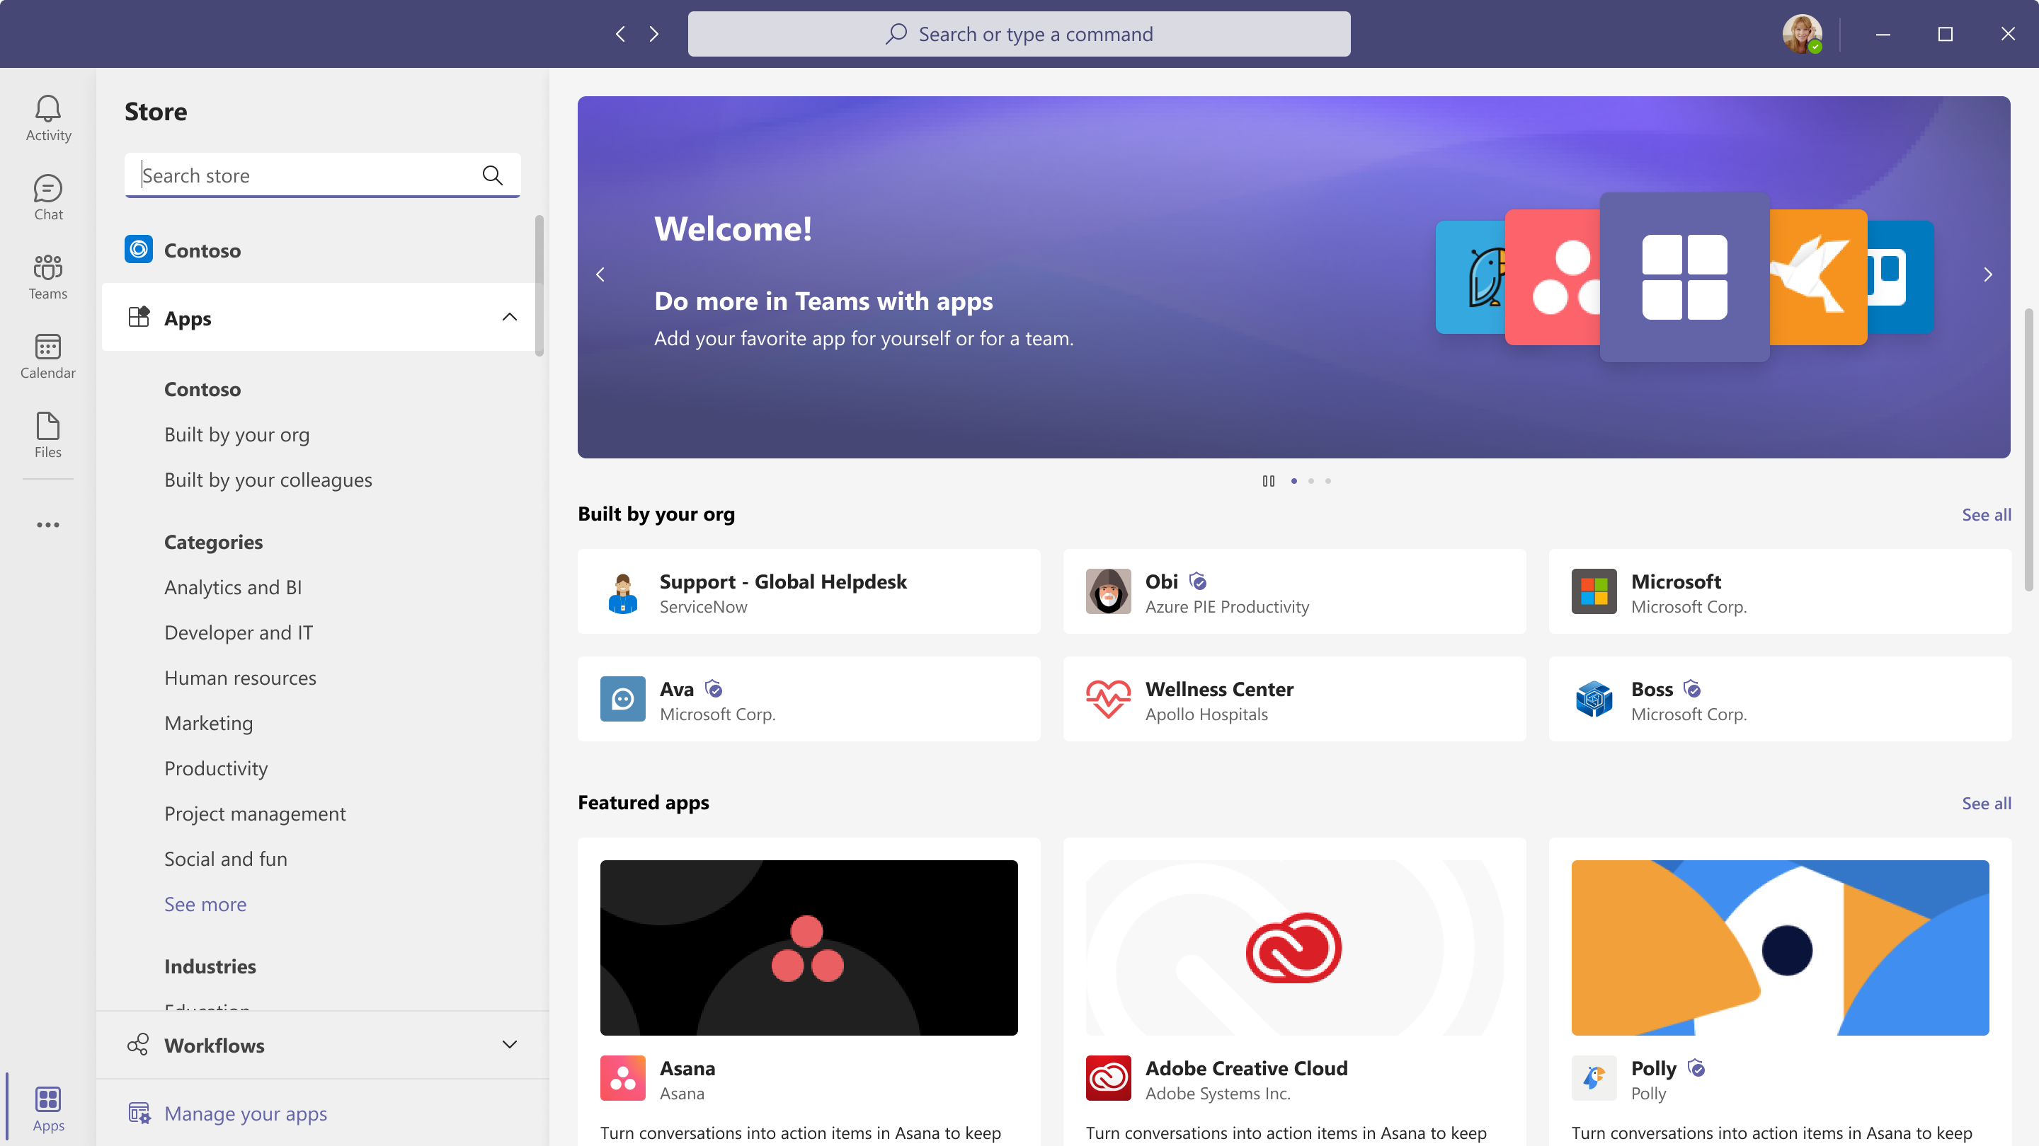
Redesigned Microsoft Teams Store Experience
Rotating banners at the top spotlighting interesting apps and scenarios
Intelligent recommendations for apps that are popular amongst colleagues and across all users on Teams
New curated surfaces showcasing collections of apps
Updated app categories to make it easier to find the apps

Slide 42
Neuigkeiten in Microsoft Teams für Admins
Real time data for Teams Meetings in Teams Admin Center (Preview)
Anonymous join policy Weitere Informationen
Teams application update for Teams phones
Redesigned Microsoft Teams Store Experience
Meeting Activities in Teams Audit Log Weitere Informationen
TLS1.2 enforcement for Direct Routing SIP interface Weitere Informationen
Teams Meeting Recordings Auto-Expiration in OneDrive and SharePoint Weitere Informationen

Slide 43
Meeting Activities in Teams Audit Log
MeetingDetail
Information about Teams meetings including the start time, end time, and URL to join the meeting
MeetingParticipantDetail
Information about the participants of a meeting, including the user ID of each participant, the time each participant joined the meeting, and the time each participant left the meeting

Slide 44
Neuigkeiten in Microsoft Teams für Admins
Real time data for Teams Meetings in Teams Admin Center (Preview)
Anonymous join policy Weitere Informationen
Teams application update for Teams phones
Redesigned Microsoft Teams Store Experience
Meeting Activities in Teams Audit Log Weitere Informationen
TLS1.2 enforcement for Direct Routing SIP interface Weitere Informationen
Teams Meeting Recordings Auto-Expiration in OneDrive and SharePoint Weitere Informationen

Slide 45
TLS1.2 enforcement for Direct Routing SIP interface
On January 3rd 2022
Retiring Transport Layer Security (TLS) versions 1.0 and 1.1
Obligating TLS1.2 usage for the Direct Routing SIP interface
SBCs must support TLS 1.2 using one of the following cipher suites
TLS_ECDHE_RSA_WITH_AES_256_GCM_SHA384 i.e., ECDHE-RSA-AES256-GCM-SHA384
TLS_ECDHE_RSA_WITH_AES_128_GCM_SHA256 i.e., ECDHE-RSA-AES128-GCM-SHA256
TLS_ECDHE_RSA_WITH_AES_256_CBC_SHA384 i.e., ECDHE-RSA-AES256-SHA384
TLS_ECDHE_RSA_WITH_AES_128_CBC_SHA256 i.e., ECDHE-RSA-AES128-SHA256

Slide 46
Neuigkeiten in Microsoft Teams für Admins
Real time data for Teams Meetings in Teams Admin Center (Preview)
Anonymous join policy Weitere Informationen
Teams application update for Teams phones
Redesigned Microsoft Teams Store Experience
Meeting Activities in Teams Audit Log Weitere Informationen
TLS1.2 enforcement for Direct Routing SIP interface Weitere Informationen
Teams Meeting Recordings Auto-Expiration in OneDrive and SharePoint Weitere Informationen

Slide 47
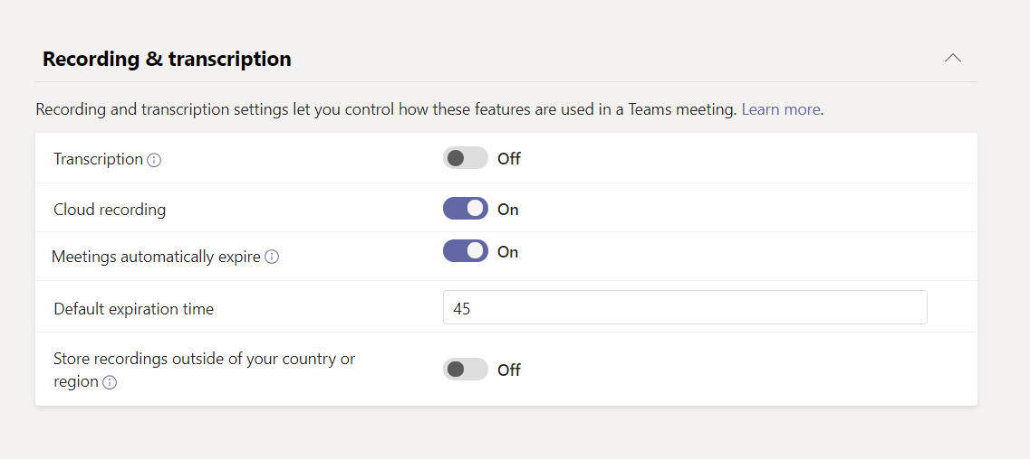
Teams Meeting Recordings Auto-Expiration in OneDrive and SharePoint
Default Auto-Expire is 60 days
Auto-Expiration is not a retention setting
Deleted recording is subject to SharePoint recycle bin settings
NewMeetingRecordingExpirationDays parameter
1 – 99.999 days
Affects recordings
Stored in new Stream (OneDrive/SPO)
Created by Teams Service only

Slide 48
Neuigkeiten in Microsoft Teams für Admins
View Only Attendee Guidance Update – more than 1.000 users Weitere Informationen
Viva Connections is now generally available Weitere Informationen
Chat with users with Teams personal accounts
Multi-language Teams meeting invite control Weitere Informationen
Announcing updated Send Feedback experience in mobile app Weitere Informationen

Slide 49
Neuigkeiten in Microsoft Teams für Admins
View Only Attendee Guidance Update – more than 1.000 users Weitere Informationen
Viva Connections is now generally available Weitere Informationen
Chat with users with Teams personal accounts
Multi-language Teams meeting invite control Weitere Informationen
Announcing updated Send Feedback experience in mobile app Weitere Informationen

Slide 50
Neuigkeiten in Microsoft Teams für Admins
View Only Attendee Guidance Update – more than 1.000 users Weitere Informationen
Viva Connections is now generally available Weitere Informationen
Chat with users with Teams personal accounts
Multi-language Teams meeting invite control Weitere Informationen
Announcing updated Send Feedback experience in mobile app Weitere Informationen

Slide 51
Chat with users with Teams personal accounts
Tenant Level
CsTenantFederationConfiguration
AllowTeamsConsumer
AllowTeamsConsumerInbound
User Level
CsExternalAccessPolicy
EnableTeamsConsumerAccess
EnableTeamsConsumerInbound

Slide 52
Neuigkeiten in Microsoft Teams für Admins
View Only Attendee Guidance Update – more than 1.000 users Weitere Informationen
Viva Connections is now generally available Weitere Informationen
Chat with users with Teams personal accounts
Multi-language Teams meeting invite control Weitere Informationen
Announcing updated Send Feedback experience in mobile app Weitere Informationen

Slide 53
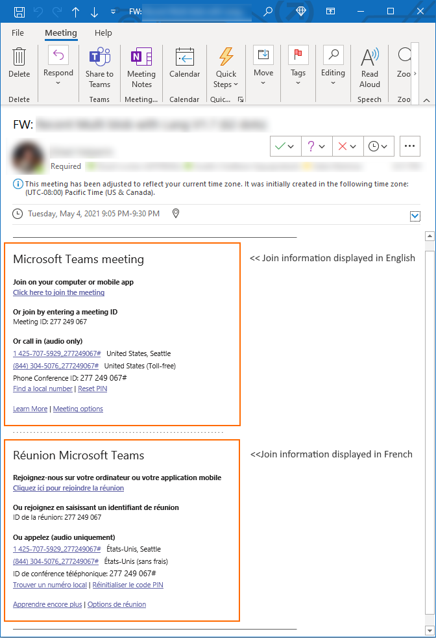
Multi-language Teams meeting invite control
Up to two languages
CsTeamsMeetingPolicy
MeetingInviteLanguages
The order of the languages in meeting invite follows the order of the languages specified in the PowerShell cmdlet
If not set on the policy (default), there will be no impact to the user and the preferred user language will take effect
Set-CsTeamsMeetingPolicy -Identity Global -MeetingInviteLanguages "en-US,fr-FR"

Slide 54
Neuigkeiten in Microsoft Teams für Admins
View Only Attendee Guidance Update – more than 1.000 users Weitere Informationen
Viva Connections is now generally available Weitere Informationen
Chat with users with Teams personal accounts
Multi-language Teams meeting invite control Weitere Informationen
Announcing updated Send Feedback experience in mobile app Weitere Informationen

Slide 55
Was ist neu in Teams – Der Blog
What’s New in Microsoft Teams - October 2021
What’s New in Microsoft Teams - November 2021
Microsoft Teams Blog
Microsoft Teams Community Blog

Slide 56
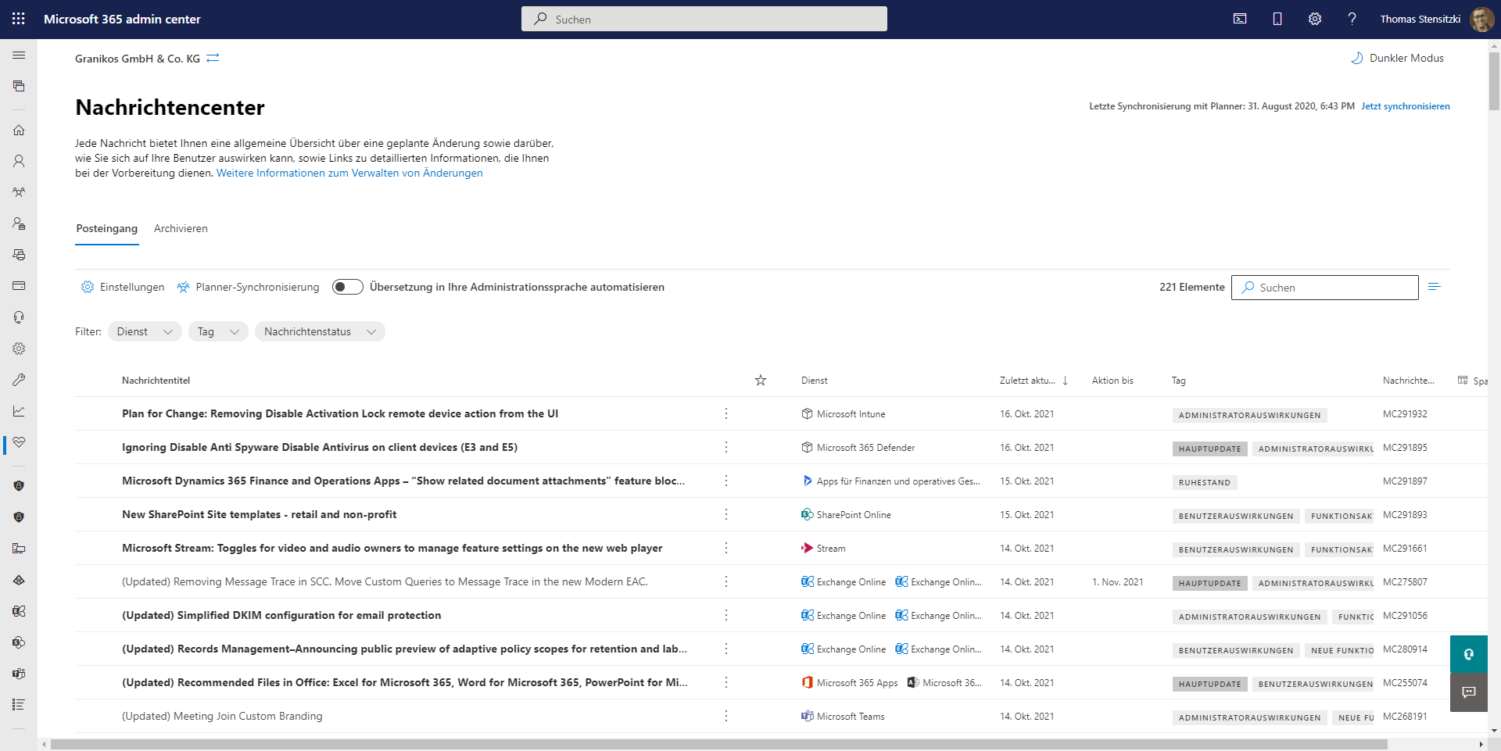
https://admin.microsoft.com/#/MessageCenter

Slide 57
Microsoft Teams – Auto Attendant und Call Queue erklärt
Thorsten Pickhan @tpickhan

Slide 58
Organisatorisches

Slide 59
Veranstaltungen
Datum
28. Januar 2022 | Teams Community Day Hybride Veranstaltung, Treffpunkt in Berlin (?) Weitere Infos Anfang Januar
17. Februar 2022 | Teams User Group Meetup #17
25./26. Februar 2022 | Scottish Summit 2022
23. März 2022 | Teams Nation
19. Mai 2022 | aMS Berlin 2022

Slide 60
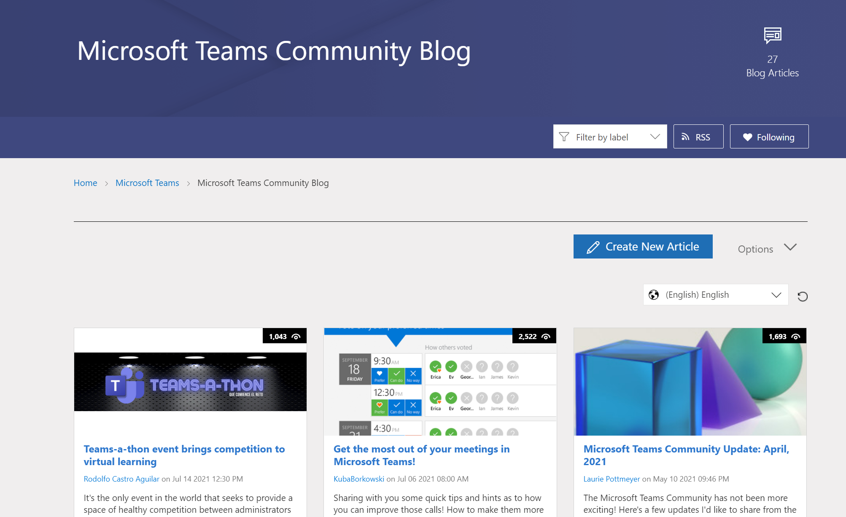
Teams Community Blog
→https://aka.ms/TeamsCommunityBlogger

Slide 61
Organisatorisches
Microsoft Community Tenant für User Groups
Teilnahme als Microsoft 365 Gast
Anmeldung: https://go.granikos.eu/TeamsUGForm
Einheitlicher Teams Meeting Teilnahme-Link
https://teamsusergroup.berlin/meetup

Slide 62
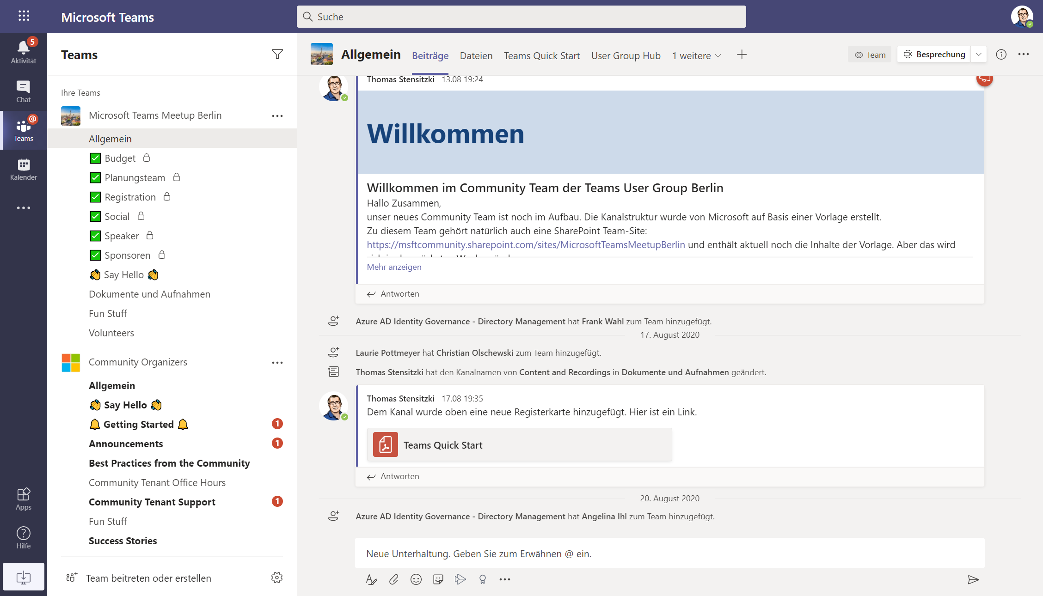

Slide 63
Vielen Dank für eure Teilnahme!
Das nächste Meetup:
→ 17. Februar 2022
https://TeamsUserGroup.Berlin/register
Spread the Word!
#TeamsUGBerlin
Aufzeichnungen unserer Meetups sind im Community Team und bei YouTube verfügbar.

Slide 64
Offene Diskussion

